Slide 1
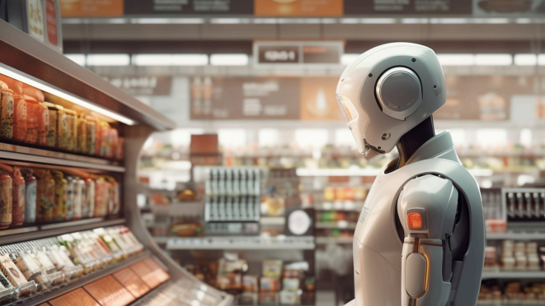
Computer Science Capstone Project
Team Name: TEAM MISSION POSSIBLE
(deadly by name & game)
Team 4

Slide 2
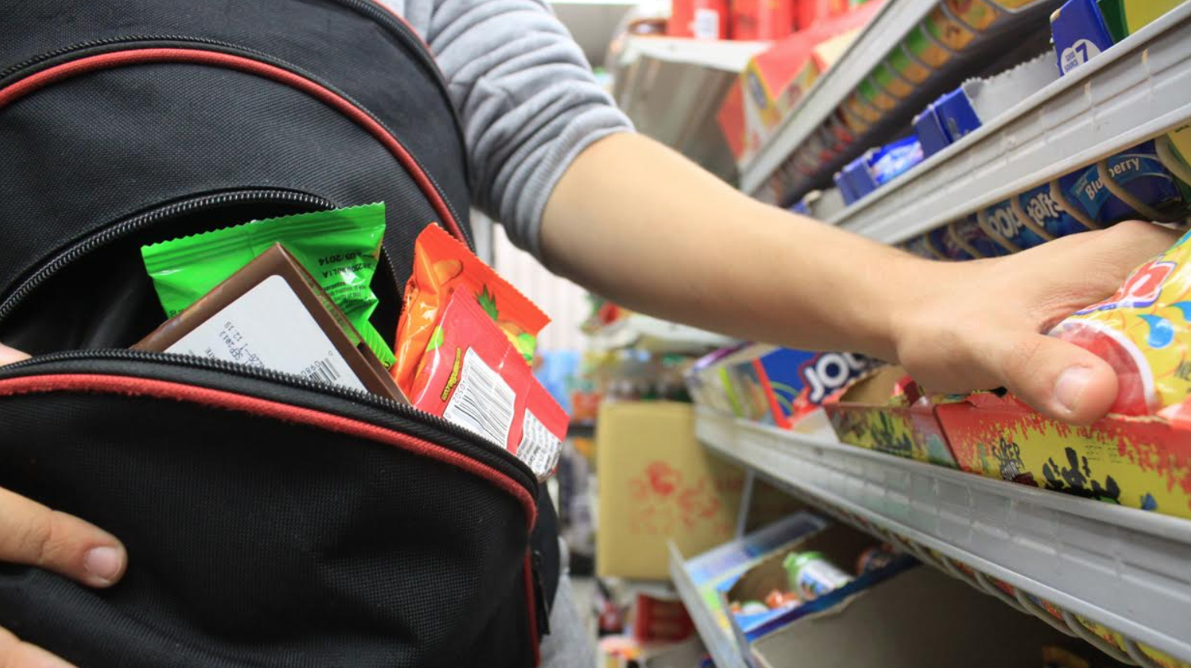


Slide 3

Team Member Roles and
Responsibilities
Improvements made from Professor Feedback
Project
Statement
Project
Description
Team Working
Agreement
Personas
Minimal Viable Product (MVP)
Technologies
Architecture
Diagrams
Schedule
Recap Sprint 1 Backlog
Product Backlog
Sprint 2 Backlog
Test cases
Stories Completed
Stories Not Completed
Metrics
Retrospective
Sprint 3 Backlog
Project Demo
GitHub Link
Live Application Demo

Slide 4
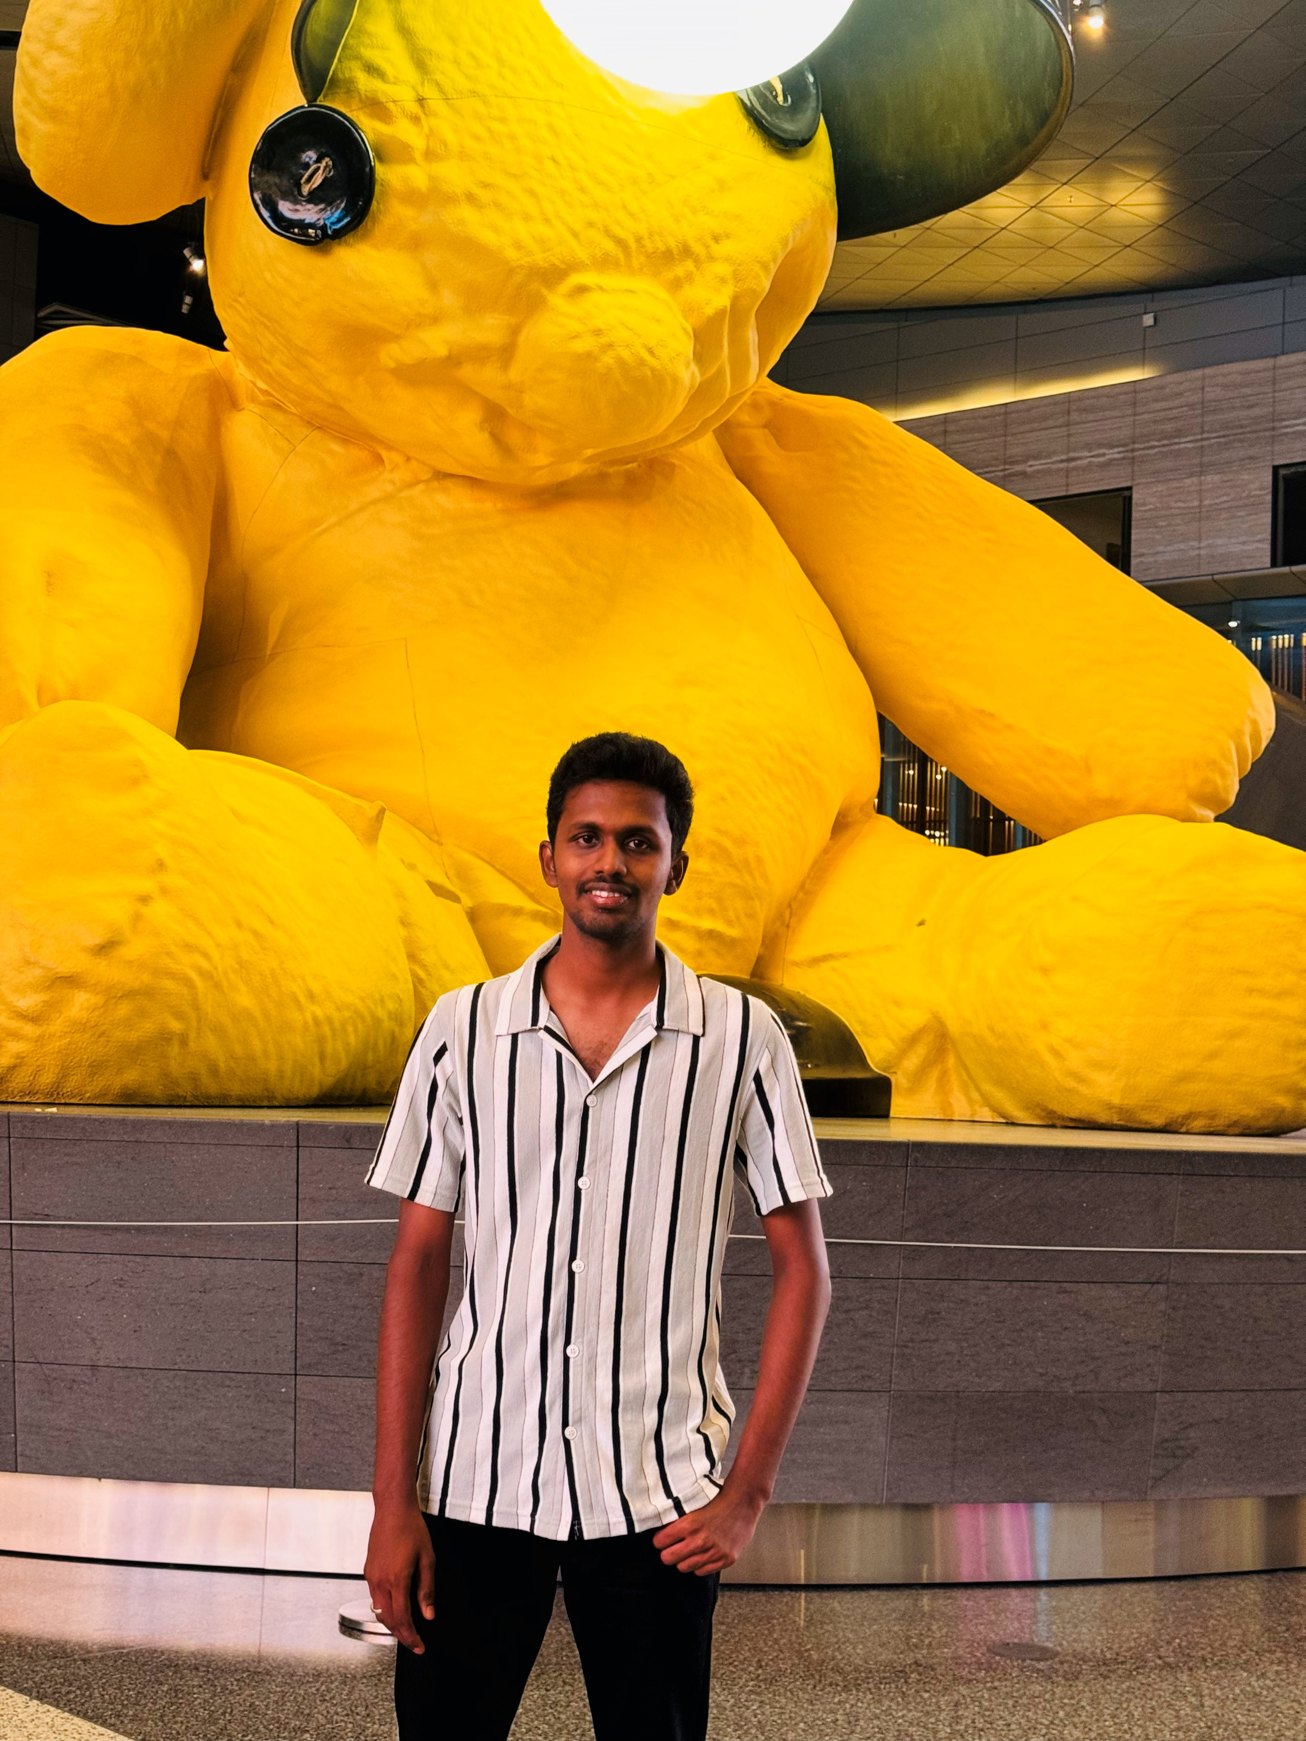
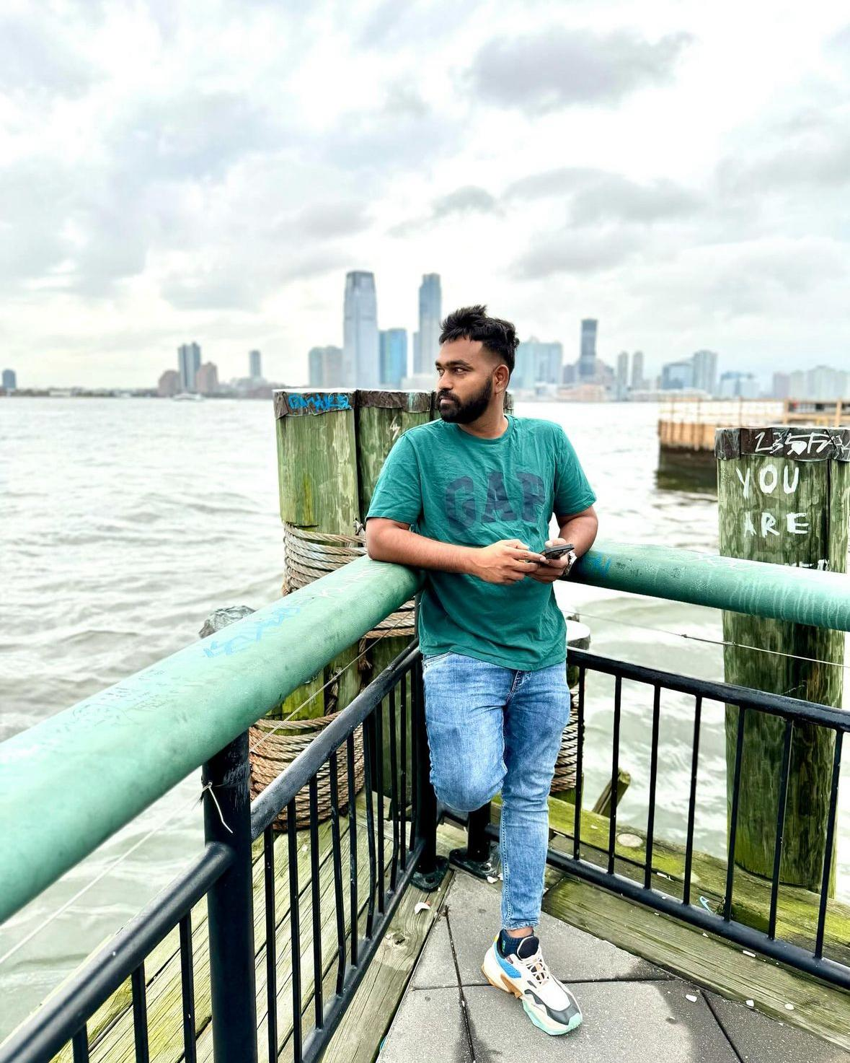

TEAM MEMBER ROLES
Shiva
Data Scientist
Prudhvi
Full Stack Developer
Vinod
Data Analyst & Product Developer

Slide 5
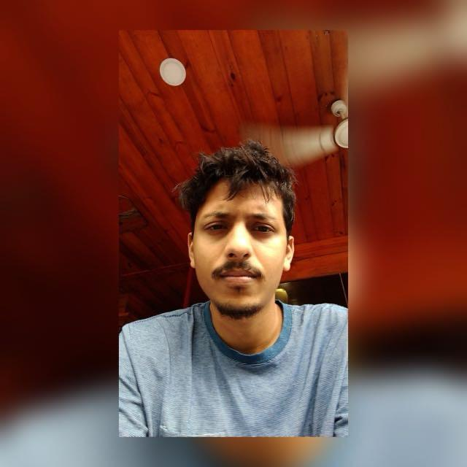

TEAM MEMBER ROLES
Mayank
Artificial Intelligence Engineer & Project Manager
Vishnu Raju
Software Developer

Slide 6
Improvements made from Feedback Professor
Revise the flow diagrams to align with updated processes or requirements.
Revise the schedule page to reflect updated project timelines and deadlines.
Update the persona’s challenges to reflect more accurate or relevant pain points.
Create or add a sprint video summarizing progress and key outcomes.
Add acceptance criteria to user stories to clearly define the conditions for completion.
Adjust the MVP to focus on the most essential features for launch or testing.

Slide 7

PROJECT STATEMENT
Shoplifting is a significant problem for supermarkets, leading to financial losses and higher customer prices. Current security methods often react to theft after it has already happened, which is ineffective. There is a clear need for a better solution that can prevent theft before it occurs. Our project aims to develop a Supermarket Theft Detection System that uses advanced technology to monitor customer behavior in real time, including computer vision and machine learning. This system will help identify suspicious activities and alert security personnel immediately, allowing them to respond quickly and reduce theft incidents. By analyzing data on theft patterns, supermarket managers can also make informed decisions to enhance security and improve the shopping experience for all customers.

Slide 8

PROJECT DESCRIPTION
Project Name: | Theft Alert
Team: | TEAM MISSION POSSIBLE (deadly by name & game)
Project Description: | The Supermarket Theft Detection System uses existing CCTV cameras and machine learning to proactively monitor customer behavior, detect suspicious activities, and alert security personnel, significantly enhancing store safety and reducing theft losses.. For retail stores who struggle with shoplifting, the Supermarket Theft Detection System is a proactive solution that leverages existing CCTV cameras and machine learning that monitor customer behavior in real time and alert security personnel. Unlike traditional reactive security measures, our application detects suspicious activities before theft occurs, significantly reducing losses and enhancing store safety.
Benefit Outcomes: | Minimizes financial losses from shoplifting. Enables quick responses from security personnel with real-time alerts. Fosters a safer shopping environment for honest customers. Provides valuable analytics on theft patterns for informed decision-making. Adaptable for implementation across multiple store locations. Works with existing security infrastructure for a smooth transition. Allows for upgrades, such as improved facial recognition and behavior prediction. Combines technology and human oversight for effective theft prevention.
GitHub Link: | https://github.com/htmw/2024F-Team4/wiki

Slide 9

PROJECT DESCRIPTION
Shoplifting poses a significant challenge for retail stores, leading to financial losses and increased consumer prices. Traditional security measures are largely reactive, addressing theft only after it occurs. Our project aims to develop a Supermarket Theft Detection System that utilizes existing CCTV cameras and machine learning to monitor customer behavior in real time. The system will analyze video footage for unusual movements and automatically alert security personnel to potential theft, enabling quick responses. This proactive approach reduces theft losses and enhances the shopping experience by fostering a safer environment. Additionally, the system is scalable for multiple locations and integrates seamlessly with current security infrastructure. By providing valuable insights into theft patterns, our innovative solution aims to revolutionize supermarket security and improve overall safety for customers and staff.

Slide 10
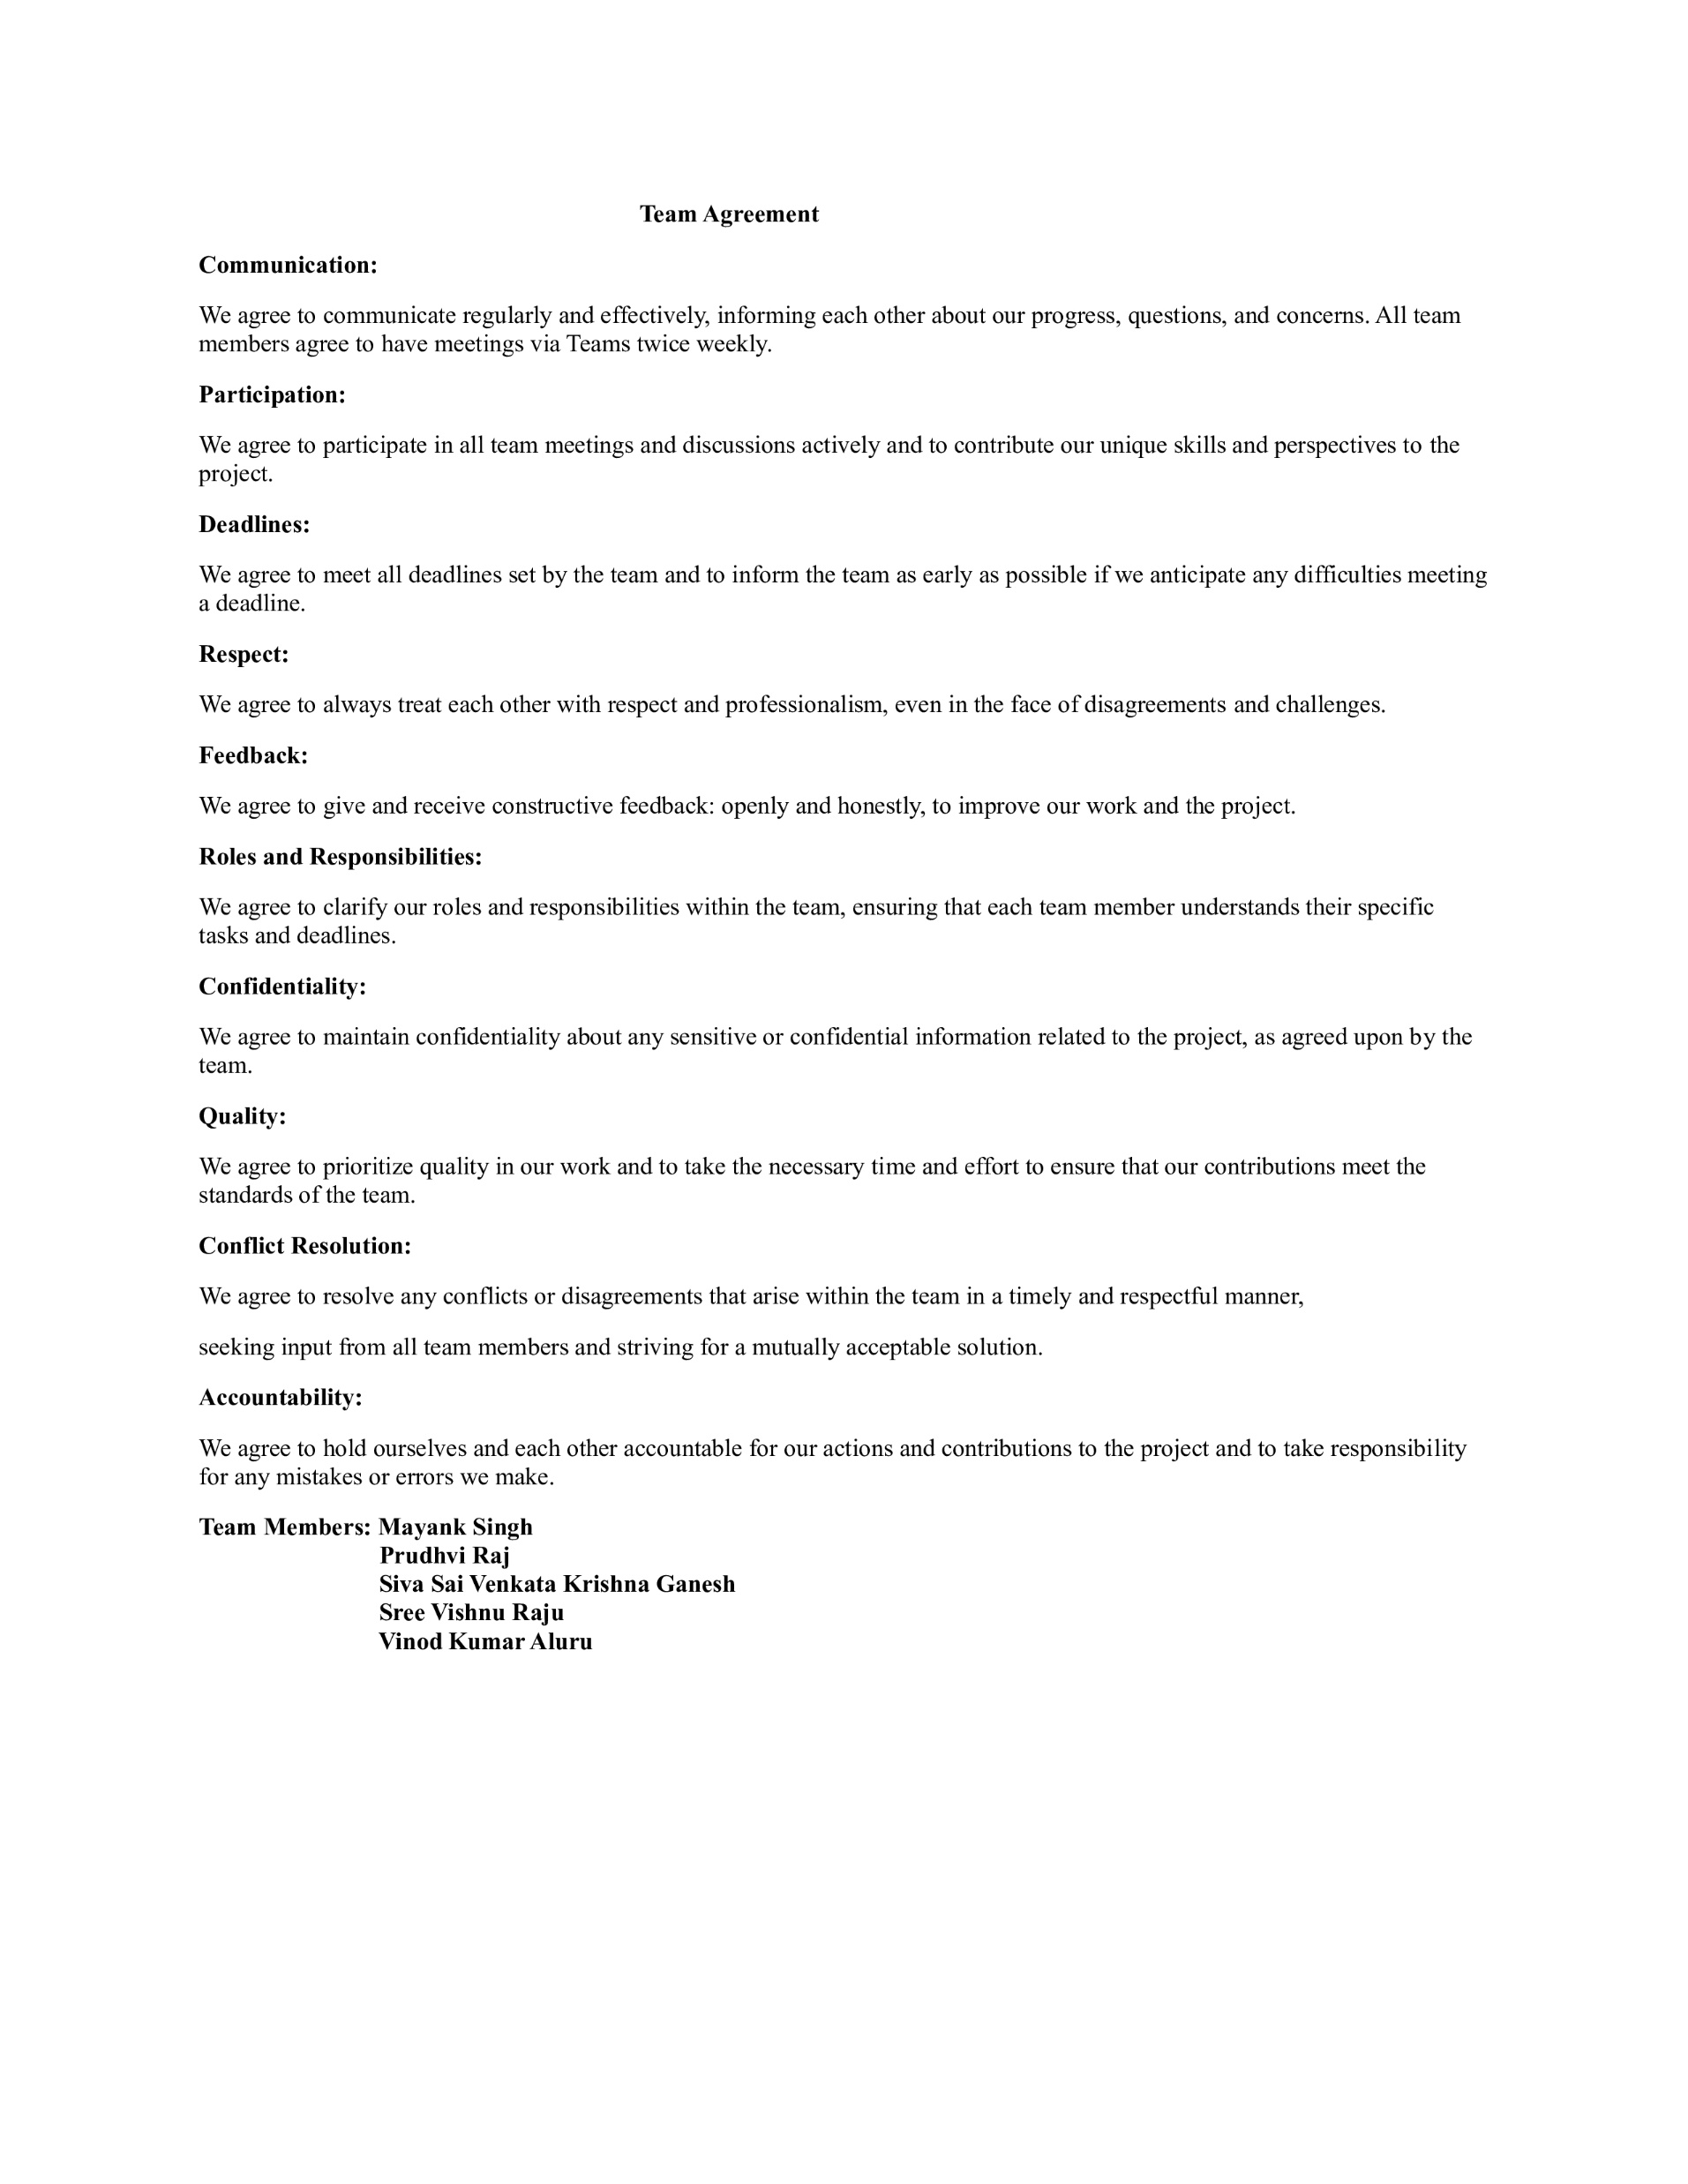

TEAM WORKING AGREEMENT

Slide 11

PERSONAS

Slide 12

PERSONAS - 1
James, a dedicated Chief Security Officer, oversees the safety of a large retail complex, drawing on years of experience to identify and mitigate potential threats.
Challenges:
Managing security across a large retail complex can be overwhelming, especially with limited personnel.
Managing security across a large retail complex can be overwhelming, especially with limited personnel.
Coordinating with multiple security personnel across a large complex can be difficult, especially when managing complex incidents that require a unified response.
James needs a way to quickly find relevant footage, especially during an incident or investigation.
Goals:
A real-time video monitoring system with AI features like facial recognition and automated alerts will help James efficiently monitor multiple areas and quickly identify threats.
Advanced systems that facilitate quick footage retrieval and automated tagging will streamline the review process, allowing James to save time and efficiently locate critical information.
Profile
Name: James
Age: 30
Location: Alabama, Ga
Job: Chief Security Officer
Salary: $112000/year
Family: wife

Slide 13
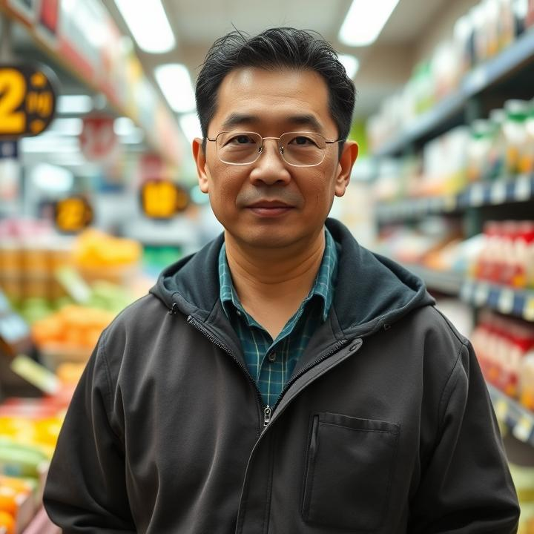
PERSONAS - 2
Mr. Wong is a dedicated convenience store owner managing a bustling shop in a vibrant neighborhood.
Challenges:
As foot traffic increases, it becomes more difficult for Mr. Wong to monitor every customer and transaction effectively, which can lead to security risks such as theft or fraudulent activities.
As a busy store owner, Mr. Wong must ensure the safety of his employees while they work, particularly during late-night shifts or in high-risk situations.
Convenience stores are often targets for shoplifting, and with more customers in-store, identifying suspicious behavior manually can be very challenging.
Goals:
A user-friendly, integrated surveillance system that provides clear alerts and easy-to-navigate interfaces will save Mr. Wong time and effort, allowing him to focus on other aspects of his business without constant troubleshooting.
Implementing an advanced surveillance system with real-time monitoring allows Mr. Wong to remotely oversee his store, enhancing security and efficiency.
Profile
Name: Mr. Wong
Age: 45
Location: New York, NY
Job: Store Owner
Family: Two children and wife

Slide 14

PERSONAS - 3
Ms. Rodriguez is a dedicated supermarket manager, responsible for the bustling operations of a large grocery store.
Challenges:
In a dynamic retail environment, it is challenging to pinpoint areas where customer flow or store layout may be causing delays or dissatisfaction without data-driven insights.
With a constantly changing shopping environment, ensuring the store layout is optimized for both customer flow and product accessibility is a time-consuming task.
Ms. Rodriguez effectively monitors every aspect of the store, which could lead to inefficiencies or missed opportunities to improve customer experience.
Goals:
She aims to use the system's data to identify bottlenecks and optimize store layout and product placement for a smoother shopping experience.
The system will enable Ms. Rodriguez to monitor customer activity and enhance customer experience.
Ms. Rodriguez plans to leverage the data to improve store performance, increase customer satisfaction, and create a safer, more enjoyable shopping experience.
Profile
Name: Rodriguez
Age: 27
Location: New Jersey, NJ
Job: Supermarket Manager
Salary: $125000/year
Family: Lives with her boyfriend

Slide 15

MINIMAL VIABLE PRODUCT
(MVP)

Slide 16
MINIMAL VIABLE PRODUCT
(MVP)
Real-time CCTV Integration - CCTV cameras to monitor customer behavior in the store.
Machine Learning Model for Theft Detection - Implement a machine learning algorithm trained to recognize basic suspicious behaviors.
Instant Alerts for Security Personnel - Set up a simple alert system to notify store security when potential theft is detected.
Data Logging for Monitoring - Enable security teams to review footage or logs in case of false positives or to understand detected patterns better.
User Interface for Security Personnel - The interface should allow security staff to assess the situation quickly.
Focus on the essentials - Streamline your video workflow with tools to upload, organize, and watch your videos.

Slide 17











TECHNOLOGIES
IDE & Additional Tools
Frontend
Backend
Database
Communication

Slide 18

ARCHITECTURE DIAGRAM

Slide 19
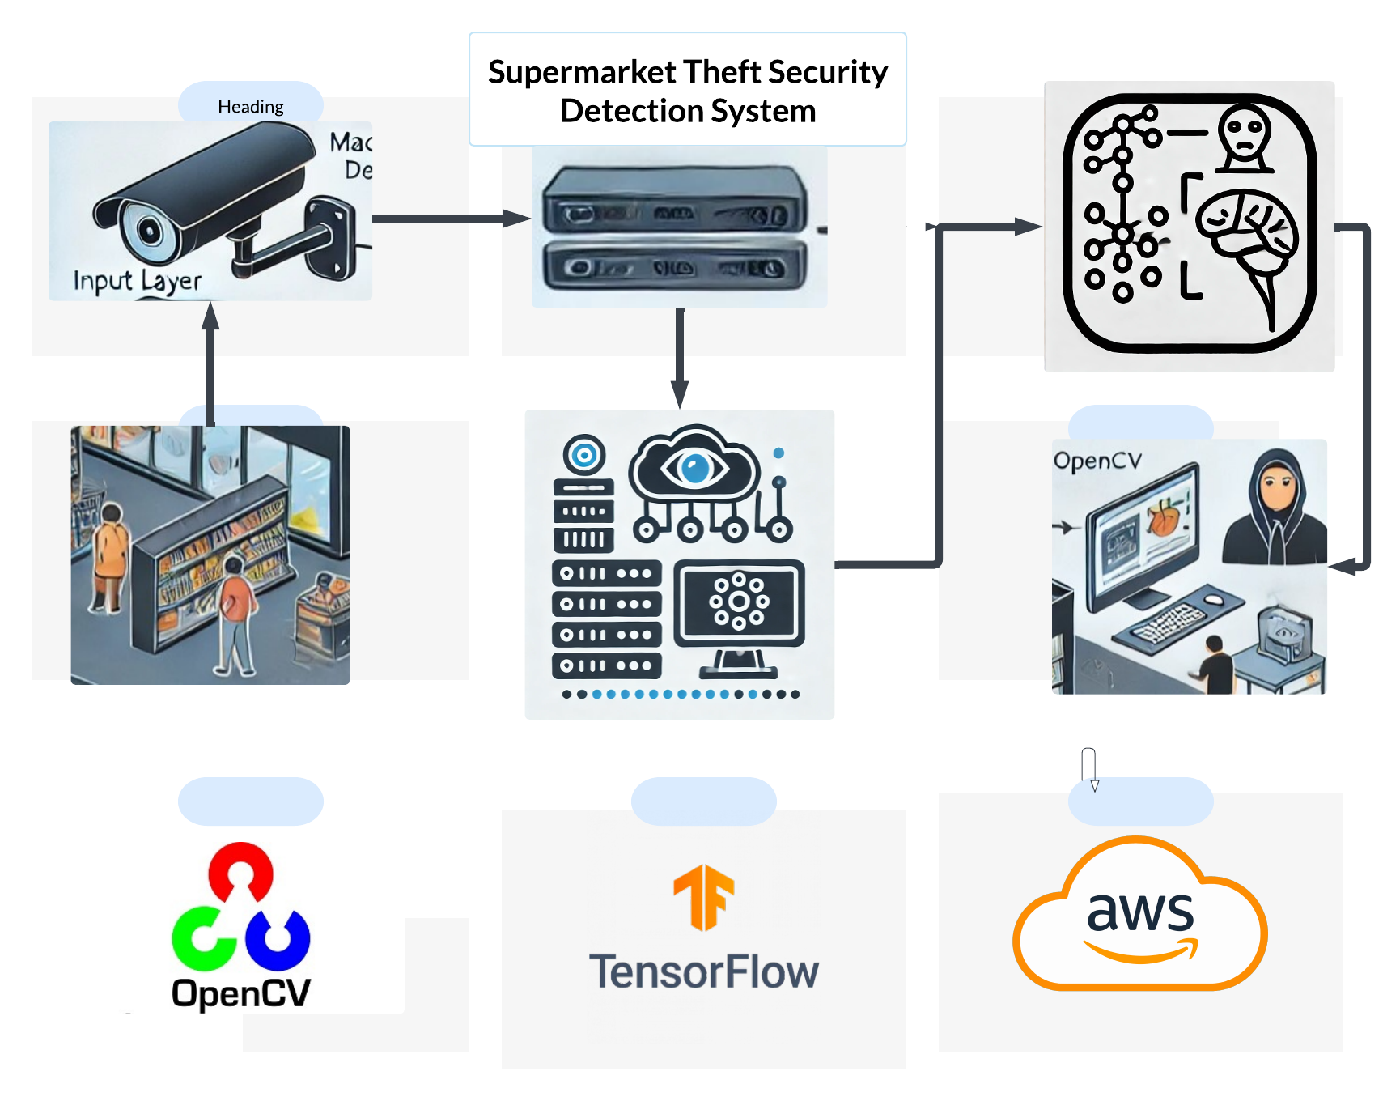
CONCEPTUAL ARCHITECTURE DIAGRAM

Slide 20
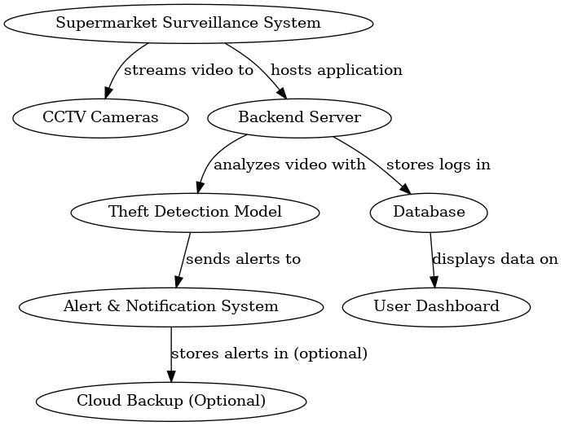
DATA FLOW DIAGRAM

Slide 21
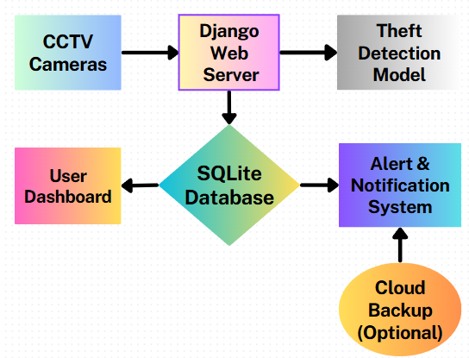
SURVEILLANCE SYSTEM ARCHITECTURE

Slide 22
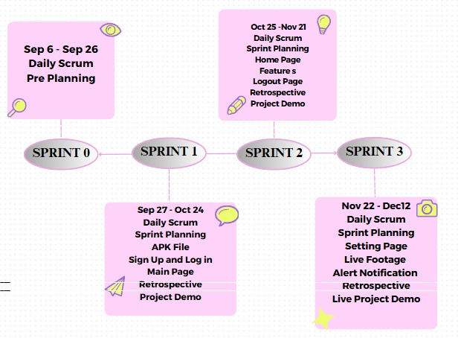
SCHEDULE

Slide 23
RECAP SPRINT 1 BACKLOG
User Story ID | Issue Type | User Story | Story Points | Status
TA - 6 | User Story | As a user, I should have an APK file that can be installed on mobile with basic functionalities. | 3 | Done
TA - 7 | User Story | As a user, I want to create my account for the application so that I can keep my account private and Signup Using my Name, Email, and Password. | 8 | Done
TA – 8 | User Story | As a user, I should be able to the user name and get registered in the application. | 3 | Done
TA – 9 | User Story | As a user, I want to log in using my user ID to access my account. | 5 | Done
TA - 10 | User Story | As a registered user I should be able to see the Main page, once I login into the application. | 5 | Done

Slide 24
PRODUCT BACKLOG
User Story ID | Issue Type | User Story | Story Points
TA – 1 | Task | To gather all the requirements for the project. | 8
TA – 2 | Task | As a team we should have team work agreement with all rules and regulations. | 3
TA – 3 | Task | As a team we should divide roles and responsibilities among ourselves to develop the project. | 5
TA – 4 | Task | As a team we should develop required technical and functional knowledge required to complete the project. | 5
TA – 5 | Task | As a team we should plan the product requirements and development plan for the project. | 3
TA – 6 | User Story | As a user, I should have an APK file that can be installed on mobile with basic functionalities. | 3
TA – 7 | User Story | As a user, I want to create an account for the application so that I can keep my account private and sign up Using my Name, Email, and Password. | 8
TA – 8 | User Story | As a user, I should be able to the user name and get registered in the application. | 3
TA – 9 | User Story | As a user, I want to log in using my user ID to access my account. | 5
TA - 10 | User Story | As a registered user I should be able to see the Main page, once I login into the application. | 5

Slide 25
PRODUCT BACKLOG
User Story ID | Issue Type | User Story | Story Points
TA – 11 | User Story | As a registered user I want to logout from the application so that I can log in again whenever I want. | 3
TA – 12 | User Story | As a user, I want to access the feature on the home page | 3
TA – 13 | User Story | As a user, I want to navigate between pages so that I can quickly access the features I need. | 5
\ TA – 14 | User Story | As a user, I want to upload fresh videos so I can watch them. | 8
TA – 15 | User Story | As a registered user, I want to see the option to change the user’s name on the settings page so I can do so. | 3
TA – 16 | User Story | As a registered user, I want to access live footage so that I can watch live videos too. | 5
TA – 17 | User Story | As a registered user, I want a functionality to enable alerts so that I can be notified about important updates. | 5
TA – 18 | Task | Preparing Deployment Manual | 3
TA – 19 | Task | Preparing User Manual | 3
TA – 20 | Task | Improving the Back End and adding Optimization Techniques in the code | 5

Slide 26
SPRINT 2 BACKLOG
User Story ID | Issue Type | User Story | Acceptance Criteria | Place | Story Points
TA - 11 | User Story | As a registered user I want to logout from the application so that I can log in again whenever I want. | Given I am a logged-in user of the application When I click on the Logout icon in the application Then I should be logged out of the application | Logout | 3
TA – 12 | User Story | As a user, I want to access the feature on the home Page | Given I am a user of the application When I open the application Then I should be able to access the features on the home page And the home page should be responsive and optimized for my device | Home Page | 3
TA – 13 | User Story | As a user, I want to navigate between pages so that I can quickly access the features I need. | Given I am a user of the application When I open the app Then I should see a well-organized and clearly labeled navigation menu that allows me to easily find the pages I need the navigation menu should be optimized for smaller screens, ensuring easy access to all pages | Home Page | 5
TA – 14 | User Story | As a user, I want to upload fresh videos so I can watch them. | Given I am a user of the application When I go to the Upload Video page Then I want to see an option to upload a new video, including the option to provide a video name | Manage Video Page | 8
TA - 15 | User Story | As a registered user, I want to see the option to change the user’s name on the settings page so that I can do so. | Given I am a user of the application When I go to the settings page Then I want to see an option to change my username so that I can update it if it was entered incorrectly | Setting Page | 3

Slide 27
TEST CASES
Test ID | User Story ID | User Story | Test Data | Steps to be taken | Expected Result | Actual Result
TT ID-6 | TA - 11 | As a registered user I want to Logout from the application so that I can log in again whenever I want. | Username: Vinod Password: Vinod@99 | When the user clicks on the application’s settings tab, the user should be able to see the logout option there and by clicking the logout option, the user account will be logged out from the application. | The user should be able to Logout from the application. | The user will be logged out from the application.
TT ID-7 | TA – 12 | As a user, I want to access the feature on the home Page | Username: Vinod Password: Vinod@99 | When the user logs into the application then the user can see the home page with some features displayed on the homepage. When the user clicks on the functionalities on the homepage, the user can do his required task without any trouble. | Users should be able to access all the features on the homepage. | Users will be able to access all the features on the homepage.
TT ID-8 | TA – 13 | As a user, I want to navigate between pages so that I can quickly access the features I need. | Username: Vinod Password: Vinod@99 | When the user opens the application, all features should be visible and properly displayed. Users can easily navigate through the app by clicking on the functional tabs to access all available features. | User should be able to access all the features and functionalities of the features in the application. | User will be able to access all the features in the application.

Slide 28
TEST CASES
Test ID | User Story ID | User Story | Test Data | Steps to be taken | Expected Result | Actual Result
TT ID-9 | TA – 14 | As a user, I want to upload fresh videos so I can watch them. | Username: Vinod Password: Vinod@99 | When the user opens the app, they are automatically directed to the "Upload Video" page. On this page, they have the option to upload a new video and provide a name for the video. | The user should be able to upload new videos and assign a name to each video during the upload process. | The user should be able to upload new videos with the video name.
TT ID-10 | TA – 15 | As a registered user, I want to see the option to change the user’s name in the settings page so that I can do so. | Username: Vinod Password: Vinod@99 | When the user opens the app, they are directed to the settings page. On this page, there's an option to change their username. If the user selects this option, they can enter and save their new username to their account. | The username should be changed in the application. | Username will be changed successfully in the applications settings page

Slide 29
Stories Completed
User Story ID | Issue Type | User Story | Story Points | Status
TA – 11 | User Story | As a registered user I want to logout from the application so that I can log in again whenever I want. | 3 | Done
TA – 12 | User Story | As a user, I want to access the feature on the home Page | 3 | Done
TA – 13 | User Story | As a user, I want to navigate between pages so that I can quickly access the features I need. | 5 | Done
TA – 14 | User Story | As a user, I want to upload fresh videos so I can watch them. | 8 | Done

Slide 30
Stories Not Completed
User Story ID | Issue Type | User Story | Story Points | Status
TA - 15 | User Story | As a registered user, I want to see the option to change the user’s name in the settings page so that I can do so. | 3 | To Do

Slide 31
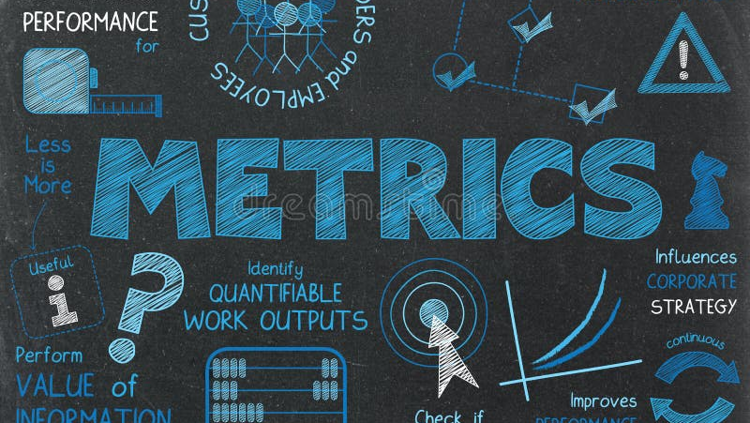

Slide 32
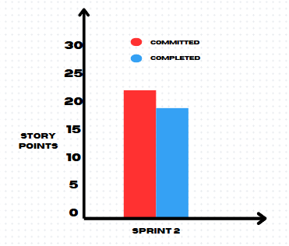
Team Velocity Chart
We committed to 22 story points and completed 19 story points.

Slide 33
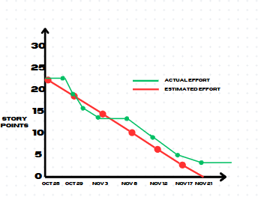
Burndown Charts
We committed to 22 story points and completed 19 story points.

Slide 34
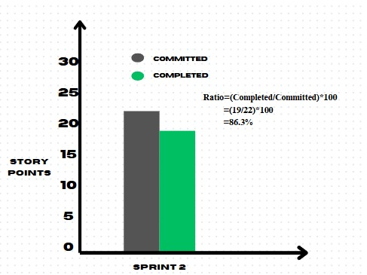
Completed/Committed Ratio
Sprint | Sprint 2
Committed | 22
Completed | 19
Ratio | 86.3%

Slide 35
SPRINT 3 BACKLOG
User Story ID | Issue Type | User Story | Story Points | Status
TA – 15 | User Story | As a registered user, I want to see the option to change the user’s name on the settings page so I can do so. | 3 | To Do
TA – 16 | User Story | As a registered user, I want to access live footage so that I can watch live videos too. | 5 | To Do
TA – 17 | User Story | As a registered user, I want a functionality to enable alerts so that I can be notified about important updates. | 5 | To Do
TA – 18 | Task | Preparing Deployment Manual | 3 | To Do
TA – 19 | Task | Preparing Tech Paper | 3 | To Do
TA – 20 | Task | Improving the Back End and adding Optimization Techniques in the code | 5 | To Do

Slide 36
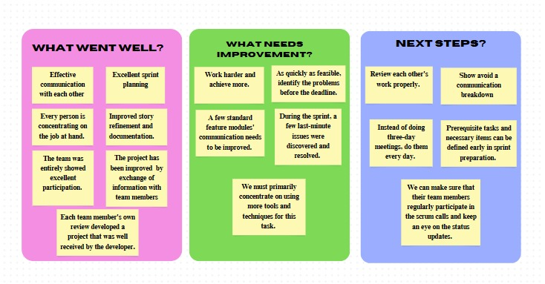
RETROSPECTIVE

Slide 37


Slide 38
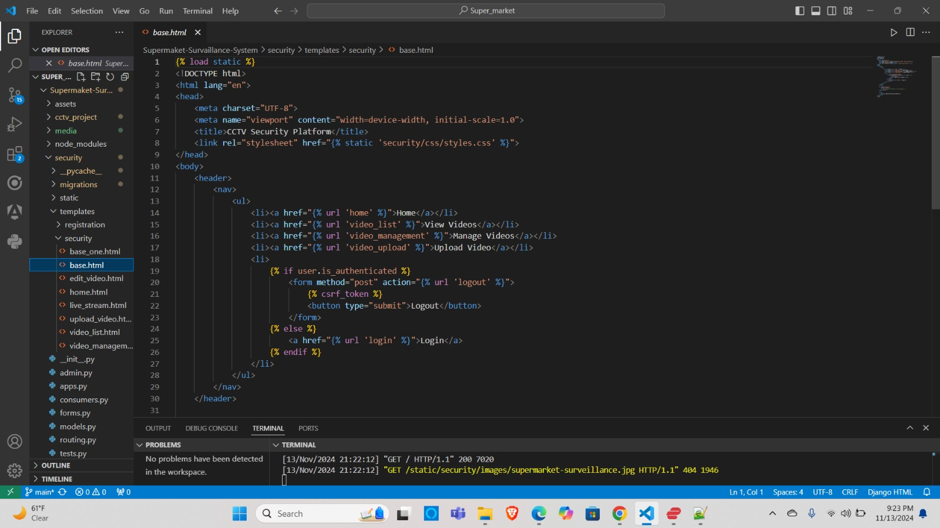
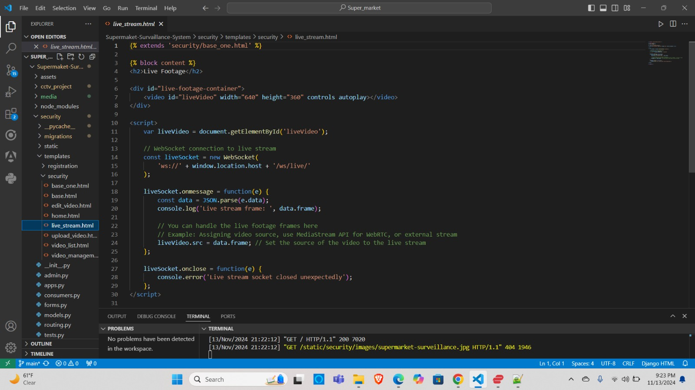
PROJECT DEMO SCREENSHOTS

Slide 39
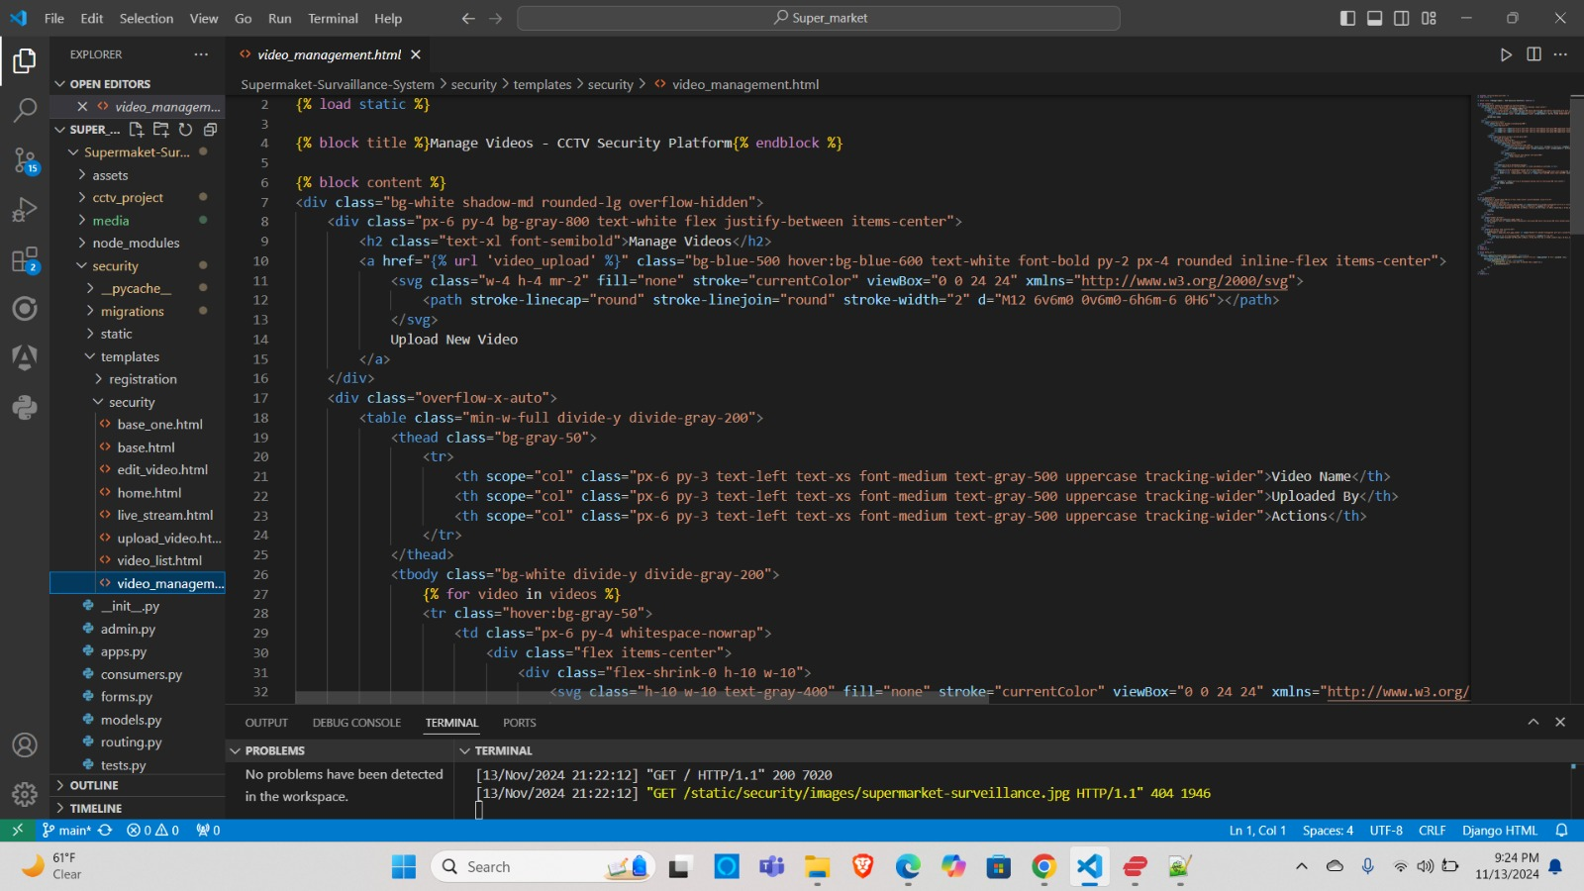
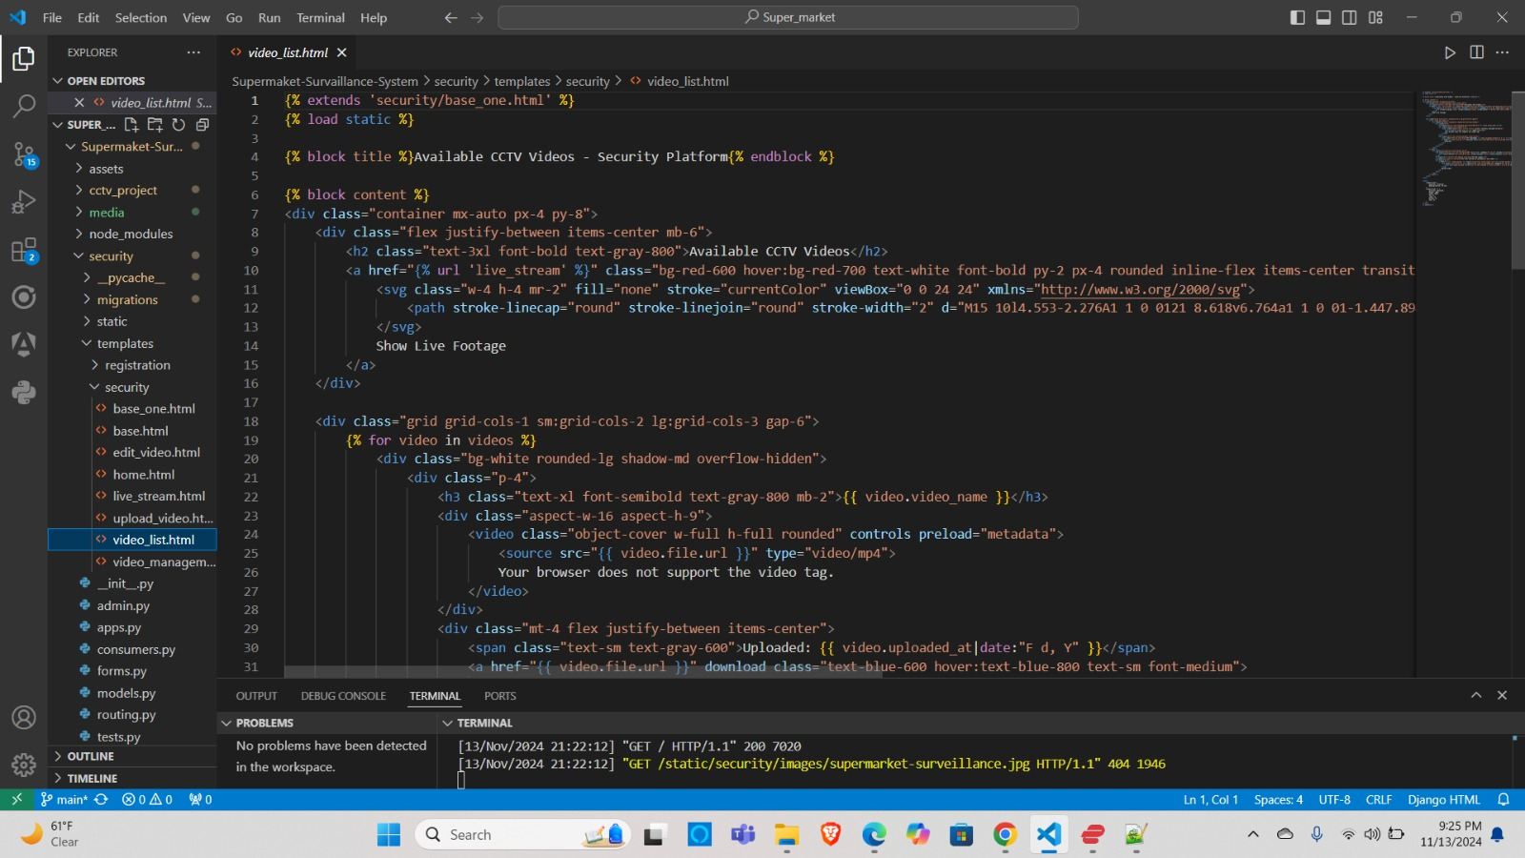
PROJECT DEMO SCREENSHOTS

Slide 40
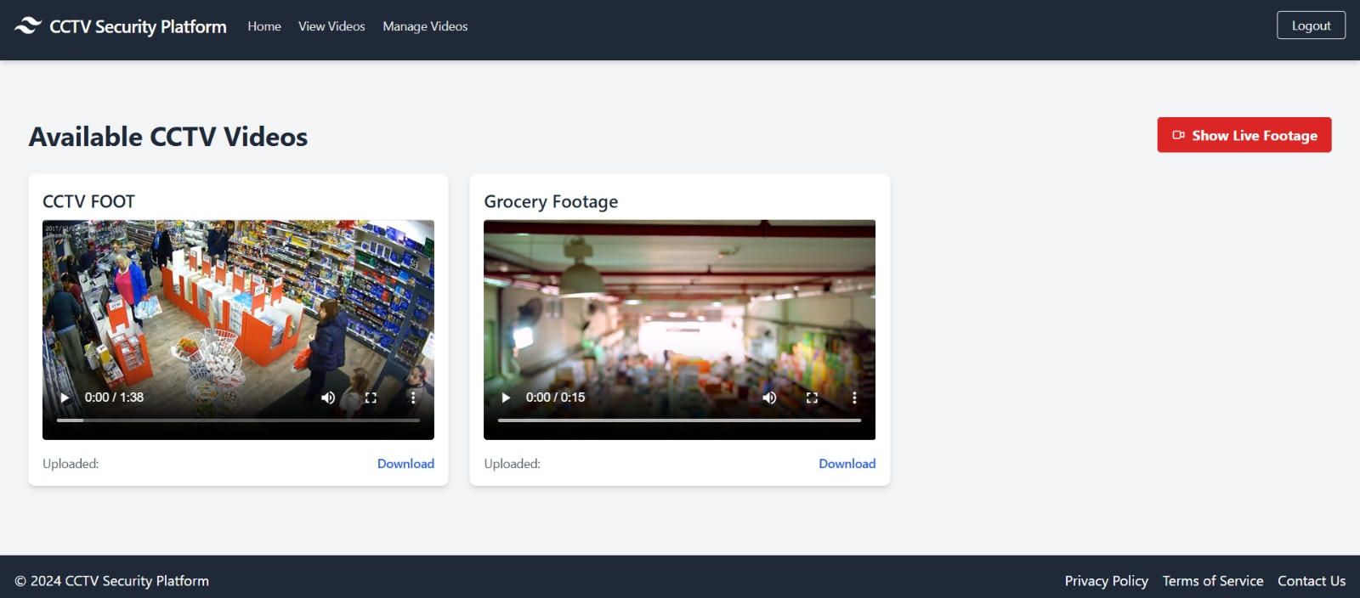
PROJECT DEMO SCREENSHOTS

Slide 41
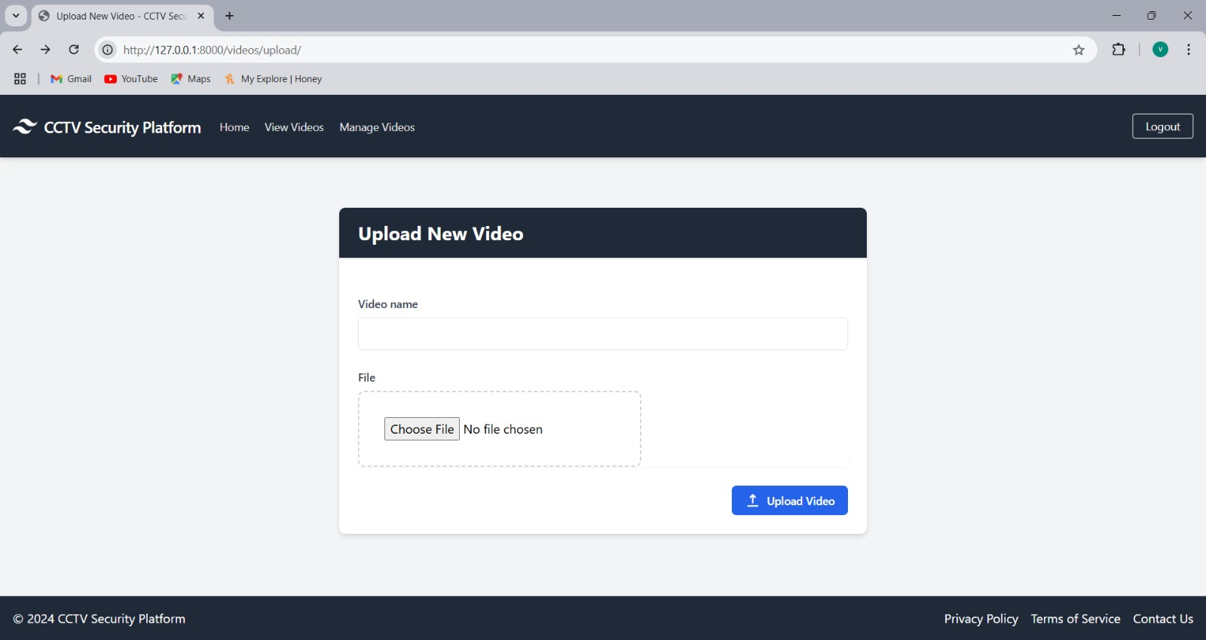
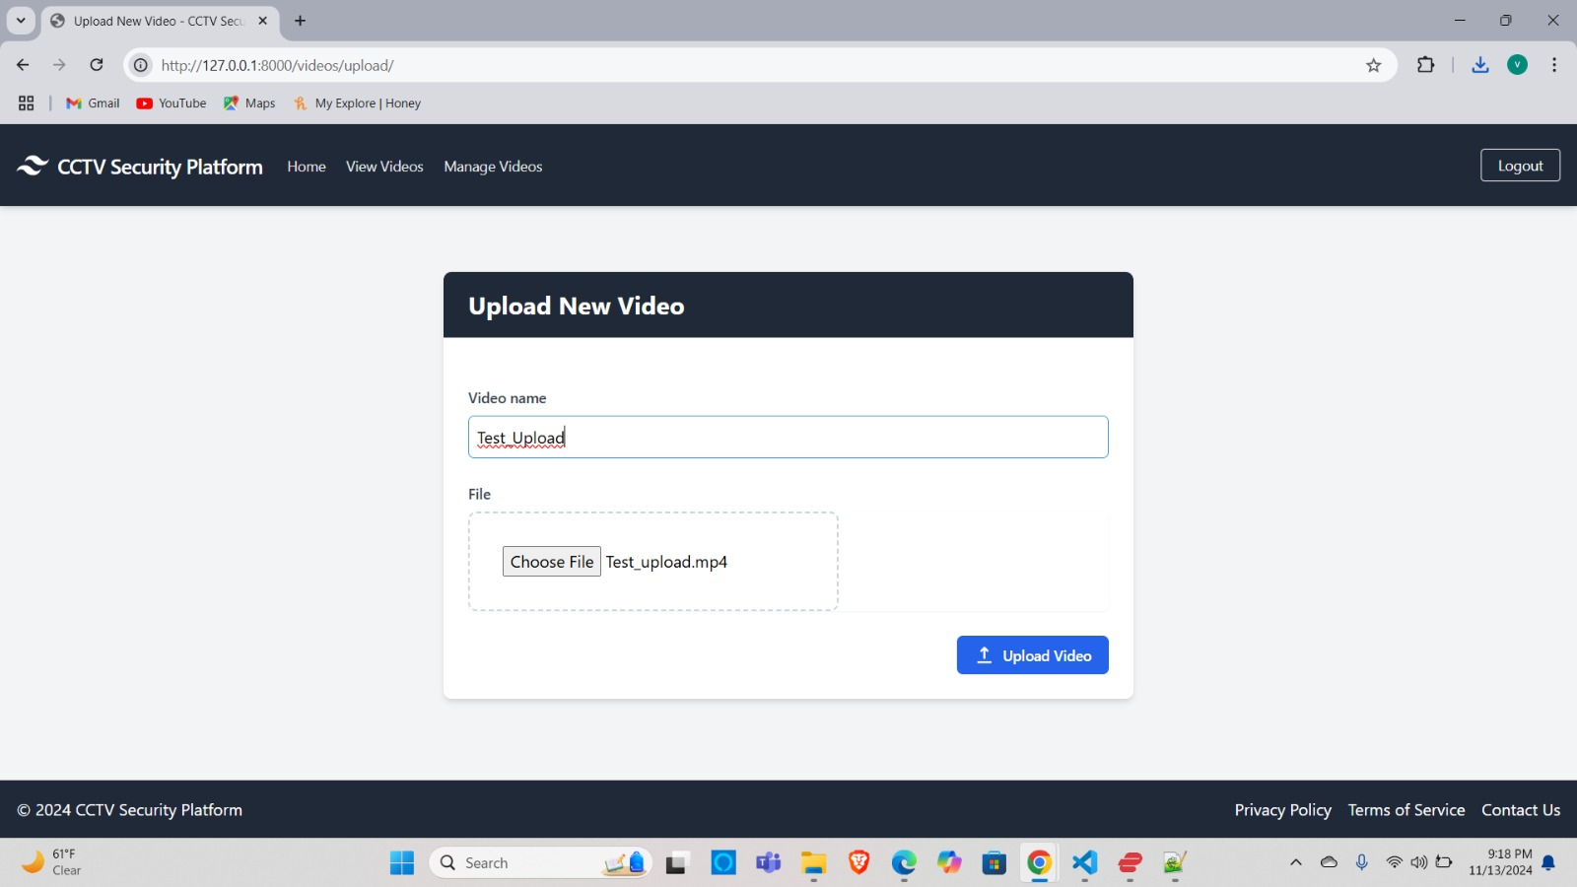
PROJECT DEMO SCREENSHOTS

Slide 42
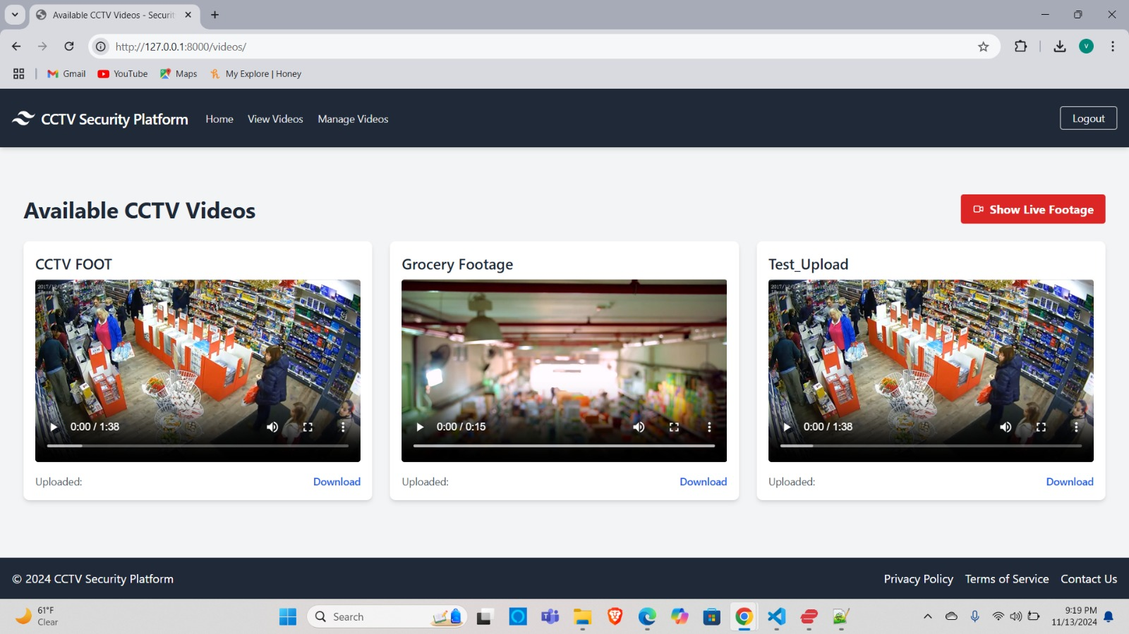
PROJECT DEMO SCREENSHOTS

Slide 43


GITHUB LINK
https://github.com/htmw/2024F-Team4/wiki

Slide 44
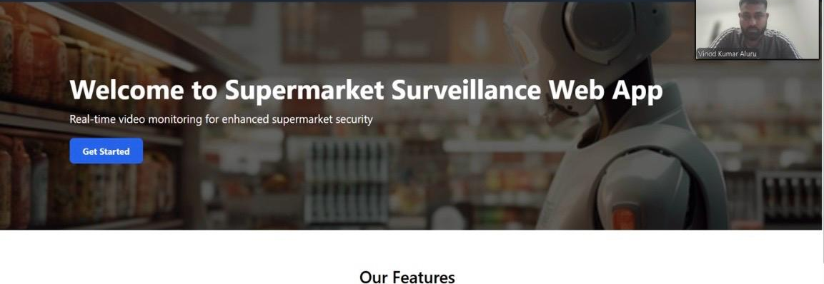
LIVE APPLICATION DEMO

Slide 45


